Slide 1
ENSEMBLE LEARNING · GAMING ANALYTICS
Boosting Algorithms
Predicting Match Win / Loss with AdaBoost, Gradient Boosting & XGBoost

Slide 2
FOUNDATIONS
Supervised Learning vs. Ensemble Learning
1
Supervised Learning
2
Ensemble Learning
One model learns a direct mapping from inputs X to labels y using labeled training data.
Prediction quality depends entirely on that one model's fit — it can underfit (too simple) or overfit (too specific).
Goal: minimize a single loss function L(y, f(x)) for one hypothesis f.
Many “weak” models are combined so their pooled prediction beats any single model.
Reduces variance (bagging) and/or bias (boosting) that a lone model can't escape.
Goal: minimize loss over an additive/combined hypothesis F(x) = Σ αᵢ hᵢ(x).
2

Slide 3
CORE IDEA
What Is Boosting?
Boosting builds models one at a time, in sequence. Each new learner focuses on the examples the previous ones got wrong — the ensemble gets stronger with every round.
Training
Data
(equal weights)
Weak Learner
#1
(shallow tree)
Reweight
misclassified
examples ↑
Weak Learner
#2
(focuses on errors)
...continues
to Learner #N
Sequential
Adaptive Weighting
Additive Model
Each model is trained after seeing the previous model's errors.
Hard examples get more attention in the next round.
Predictions are combined, not replaced — F(x) = Σ αᵢhᵢ(x).
3

Slide 4
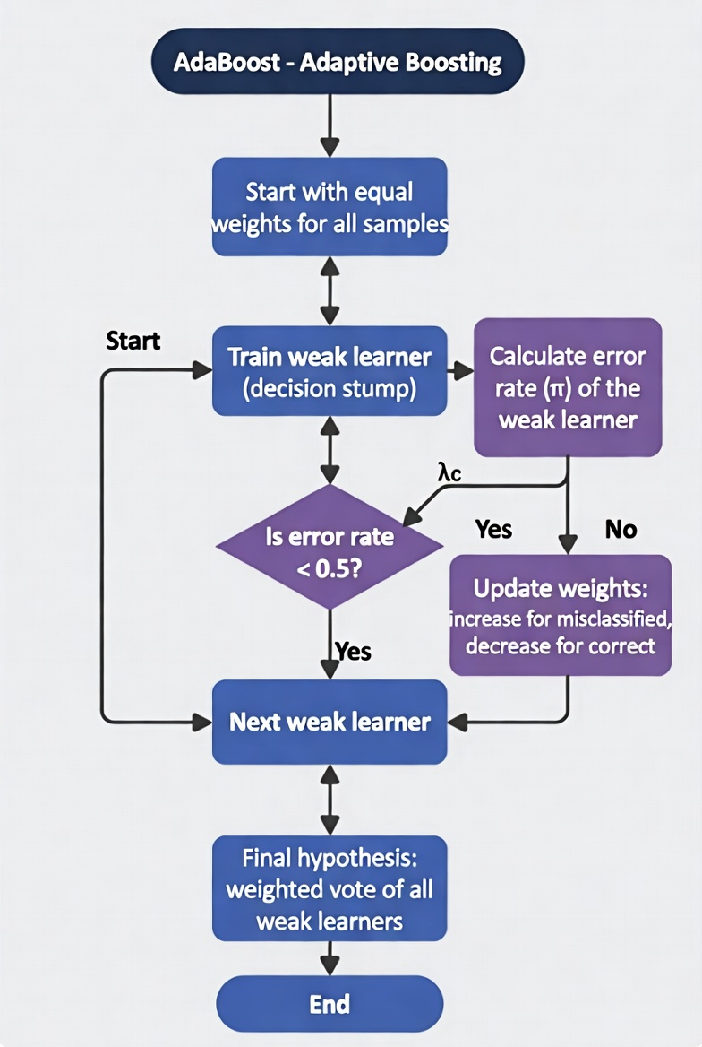
THE MATHEMATICS
AdaBoost — Adaptive Boosting
AdaBoost is a boosting algorithm that combines multiple weak learners (usually decision stumps) sequentially to create a strong classifier. Each new model focuses on correcting the mistakes of the previous ones.
Strength: Good for reducing bias, but limited by shallow trees.
1
3
4
4

Slide 5
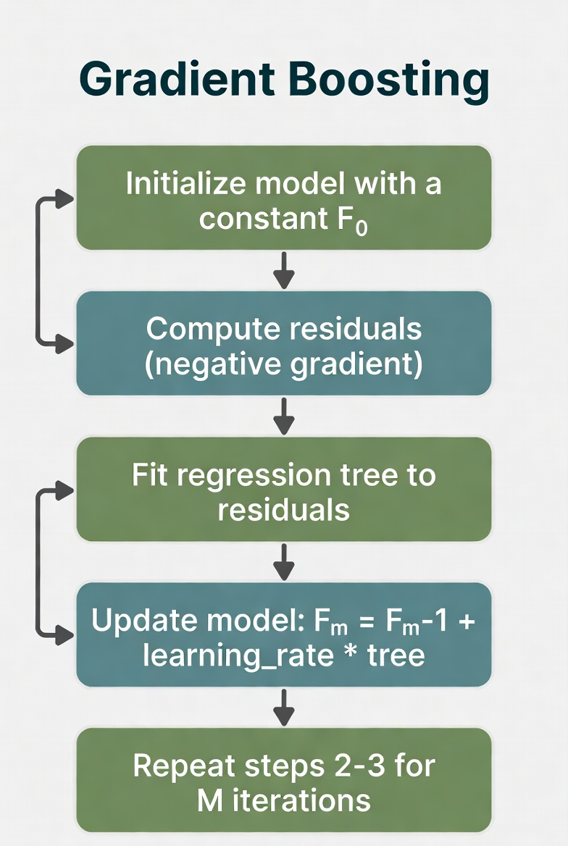
Gradient Boosting
Gradient Boosting is an ensemble technique that builds models sequentially by fitting new trees to the residual errors (mistakes) of the current ensemble. It uses gradient descent to minimize the loss function.
Strength: Very powerful for capturing complex patterns.

Slide 6
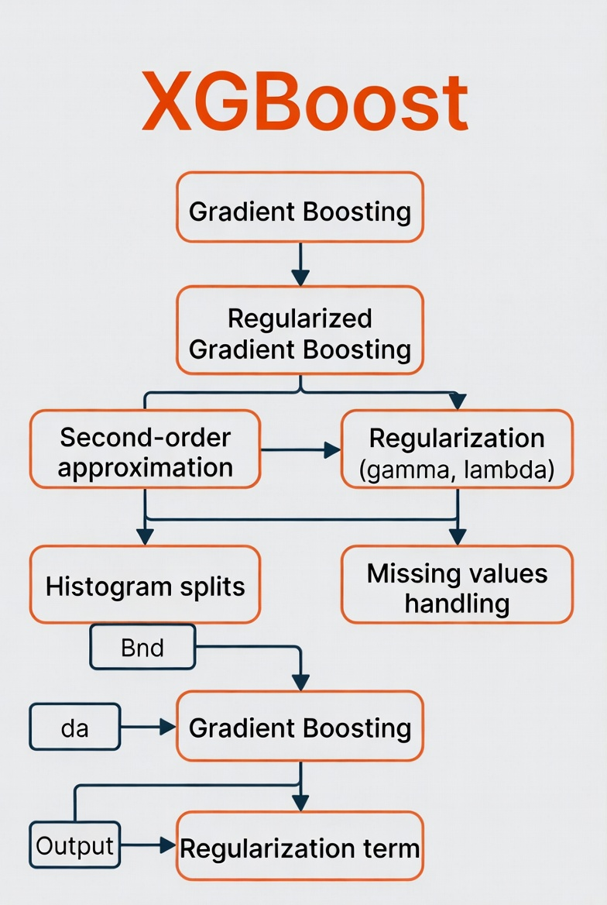
XGBoost — Regularized Gradient Boosting
XGBoost is a highly optimized and regularized version of Gradient Boosting. It is one of the most popular and powerful machine learning algorithms, especially in competitions.
Why it Wins: Best accuracy + speed + regularization.

Slide 7
Thank You
Boosting Algorithms — Gaming Case Study
13

